Slide 1
Wynne’s Coaches
Group 36
Christopher Aldred
Jack Hoyle
Sean Grady
Jake Godfrey
Conor Colgan

Slide 2
Introduction
Wynne’s Coaches
We have been given a set time for this project, we have all pulled together and made a professional program, which is fully functional with all the trimmings. Our program is designed and suited for Wynne’s Coaches, to allow you to manage your company with a little more ease.

Slide 3
Meet the team!
Wynne’s Coaches
We have 5 team members, all of which have worked to their limit to make this project become a possibility. Unfortunately one of our team members has been unavailable due to mitigating circumstances, but still contributed whenever they could.
Jack and Christopher – Programing and design.
Sean – Reports.
Jake – Documentation.

Slide 4
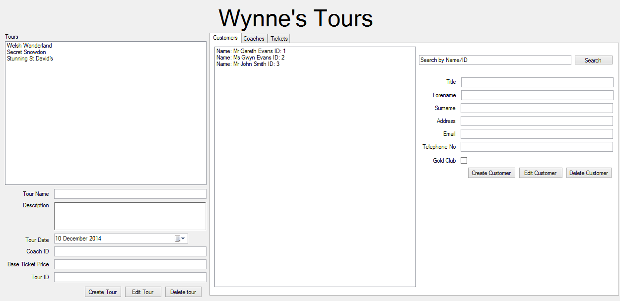
The finished Program - Customers
Wynne’s Coaches

Slide 5
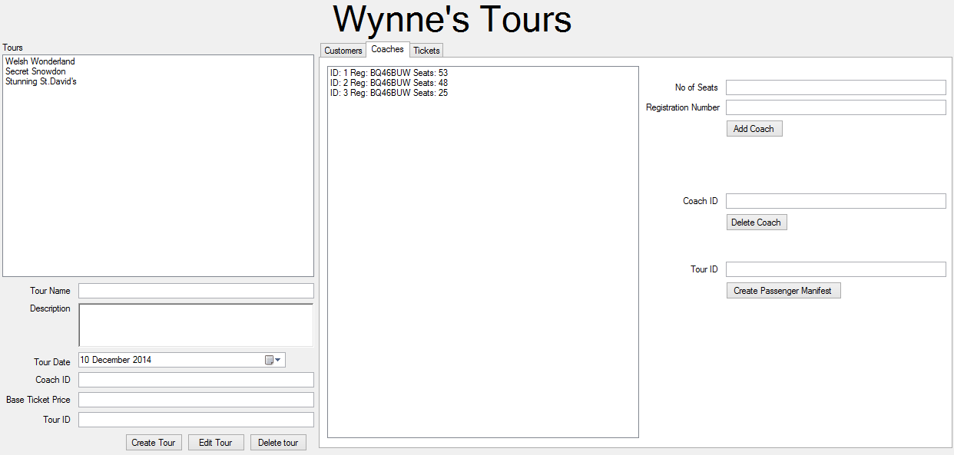
The finished Program - Coaches
Wynne’s Coaches

Slide 6
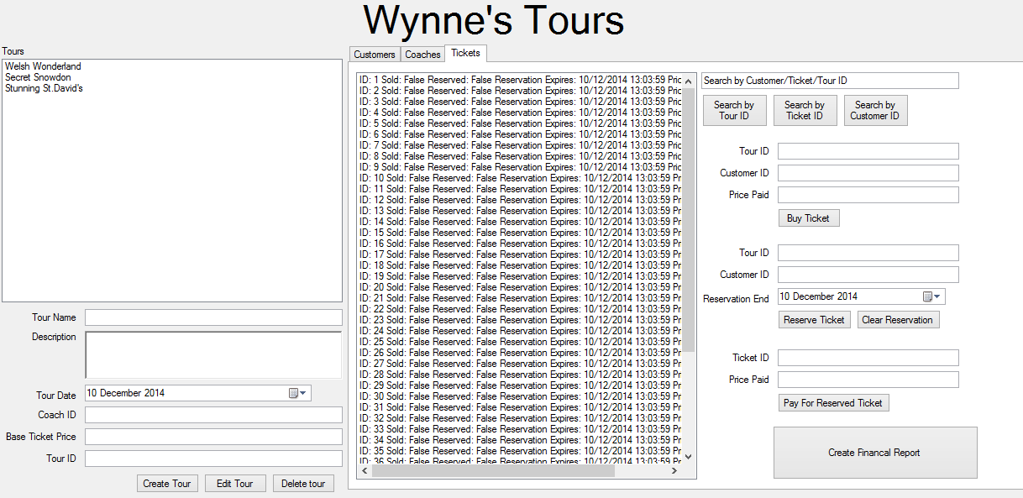
The finished Program - Tickets
Wynne’s Coaches

Slide 7
Management of the team
Wynne’s Coaches
We all function together as a great team, each helping one another by setting tasks and giving advice on colleagues work.
A role for leader was not set in stone, but a figure closest to this was Jack, giving support and organising the rest of the team. If anyone had an issue they would address him for advice and support.
Each team member played an important role, we all helped each other and finished this project in good time.

Slide 8
Any Questions?
Wynne’s Coaches
Thank you for listening to our presentation, we have all enjoyed creating this program for you, do you have any queries?

